Slide 1

CSI Ezekiel

Slide 2
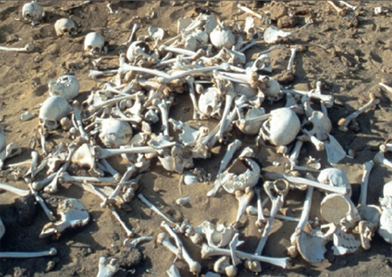
Ezekiel 37:1-14
Notes:
The hand of the Lord was on me, and he brought me out by the Spirit of the Lord and set me in the middle of a valley; it was full of bones. ² He led me back and forth among them, and I saw a great many bones on the floor of the valley, bones that were very dry. ³ He asked me, “Son of man, can these bones live?”
I said, “Sovereign Lord, you alone know.”
⁴ Then he said to me, “Prophesy to these bones and say to them, ‘Dry bones, hear the word of the Lord! ⁵ This is what the Sovereign Lord says to these bones: I will make breath^{[a]} enter you, and you will come to life. ⁶ I will attach tendons to you and make flesh come upon you and cover you with skin; I will put breath in you, and you will come to life. Then you will know that I am the Lord.’”
⁷ So I prophesied as I was commanded. And as I was prophesying, there was a noise, a rattling sound, and the bones came together, bone to bone. ⁸ I looked, and tendons and flesh appeared on them and skin covered them, but there was no breath in them.
⁹ Then he said to me, “Prophesy to the breath; prophesy, son of man, and say to it, ‘This is what the Sovereign Lordsays: Come, breath, from the four winds and breathe into these slain, that they may live.’” ¹⁰ So I prophesied as he commanded me, and breath entered them; they came to life and stood up on their feet—a vast army.
¹¹ Then he said to me: “Son of man, these bones are the people of Israel. They say, ‘Our bones are dried up and our hope is gone; we are cut off.’ ¹² Therefore prophesy and say to them: ‘This is what the Sovereign Lord says: My people, I am going to open your graves and bring you up from them; I will bring you back to the land of Israel. ¹³ Then you, my people, will know that I am the Lord, when I open your graves and bring you up from them. ¹⁴ I will put my Spirit in you and you will live, and I will settle you in your own land. Then you will know that I the Lord have spoken, and I have done it, declares the Lord.’”

Slide 3
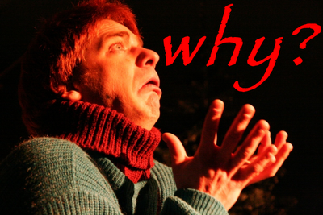
Why are we reading this today?
Notes:
We are nearing the resurrection of Jesus at Easter.
The bringing back the dead to Life.

Slide 4
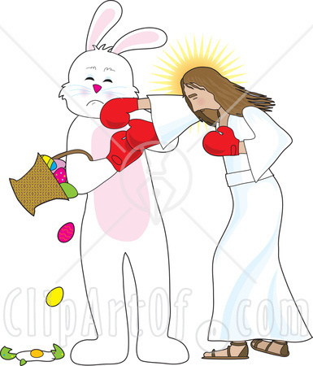
How is this different from the Easter?
Notes:
First, there are bones. The story also shows us the cultural idea of how humans are put together.
The bones are brought back to life into an army.

Slide 5
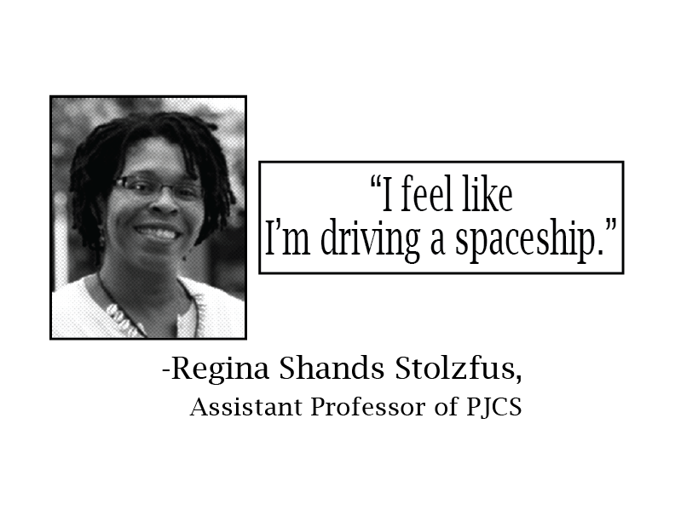
Sometimes you need the context
Notes:
Sometimes the verse itself loses a lot of the whole story. You lose the main them of Ezekiel, it is a story of hope in Exile.

Slide 6
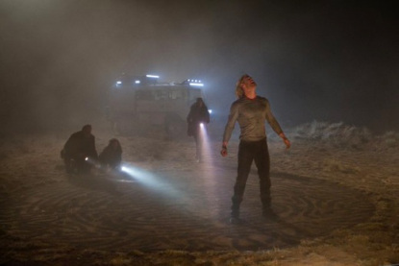
Kind of like Thor
Notes:
In Thor, the King banish Thor to earth because of his arrogance. This is similar to the story of Ezekiel.
God banished the chosen ones due to their arrogance.

Slide 7

Notes:
So let’s look at the whole book and Ezekiel’s life to understand the whole story.

Slide 8
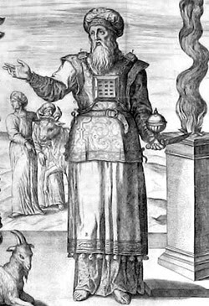
What happened to Zeke?
Notes:
Ezekiel was a member of the Priestly class of Israel. The Babylonians conquer them. When a rebellion was started, they took him out of his home and shipped him to Babylon.

Slide 9
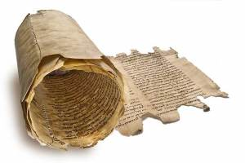
Queue the book of Zeke
Notes:
At this point in his life is when the Book of Ezekiel starts off.

Slide 10
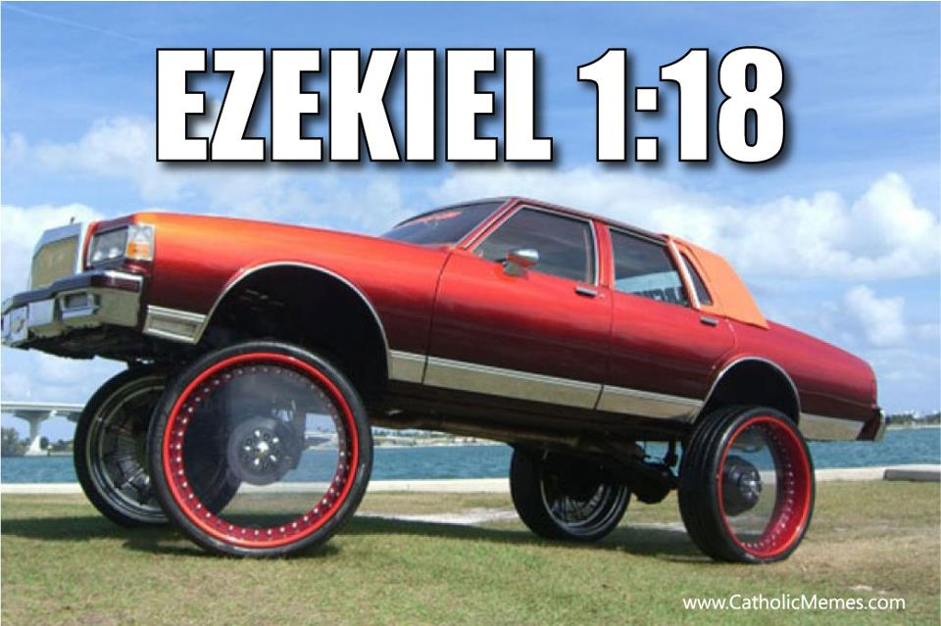
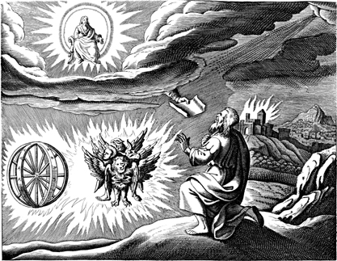
Yahweh appears in his low-rider
Notes:
Click to show more realistic depiction of verse.
Yahweh appears in a chariot with 4 different animals pulling it.

Slide 11
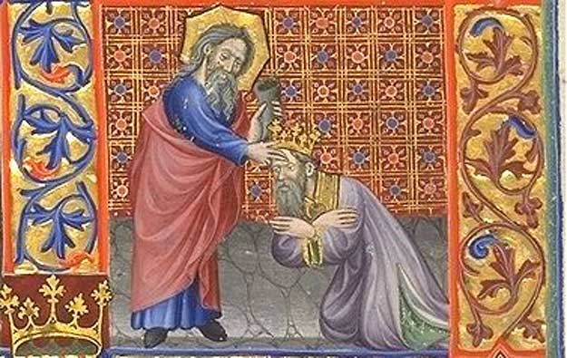
Appoints him a prophet
Notes:
Yahweh talks to him. Calls him Son of Man. Tells him to prophesize to various people and things.
Son of man could just mean Human
Appears 107 time in the Hebrew Bible
93 Times in Ezekiel
Jesus
“The” son of man
Might just be a grammar thing in Aramaic
81 times in the New Testament

Slide 12

First thing, your enemies stink
Notes:
Yahweh tells Ezekiel to basically tell off the enemies who have wrong the Israelites.

Slide 13
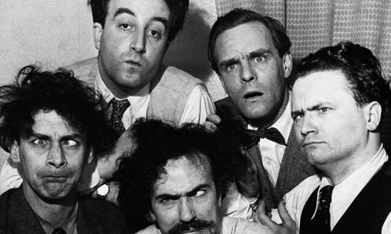
But your homies stink too
Notes:
He then tells him to tell the Israelites of various ilk that they are like prostitutes. It is definitely a PG-13 book at the very least.
He also says they are like selfish Shepherds but he will be their shepherd.

Slide 14
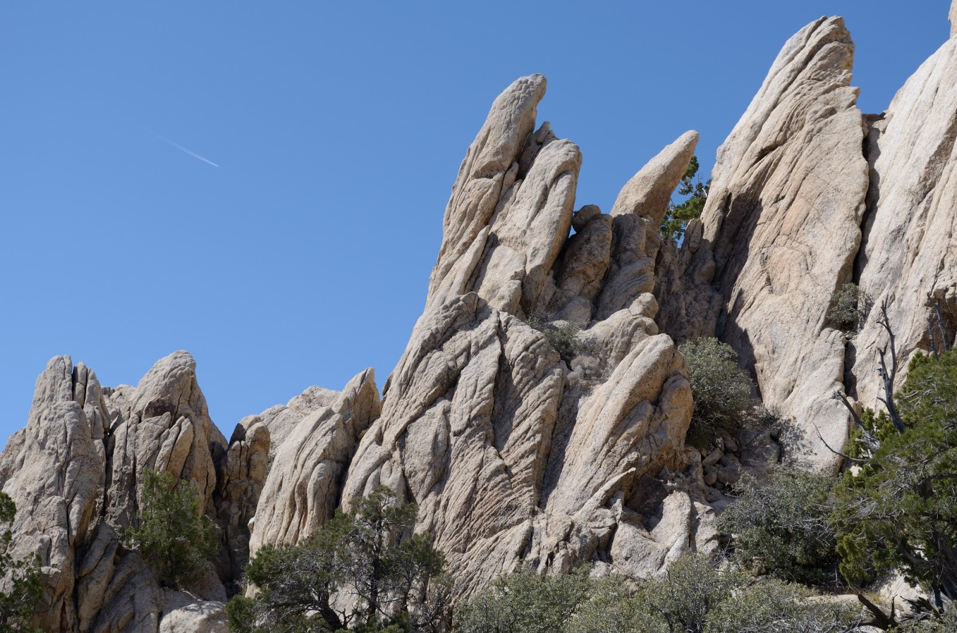
And tell these other things stuff
Notes:
Yahweh tells him to preach to mountains, then assures him Isreal will be restored and then we get to our story

Slide 15
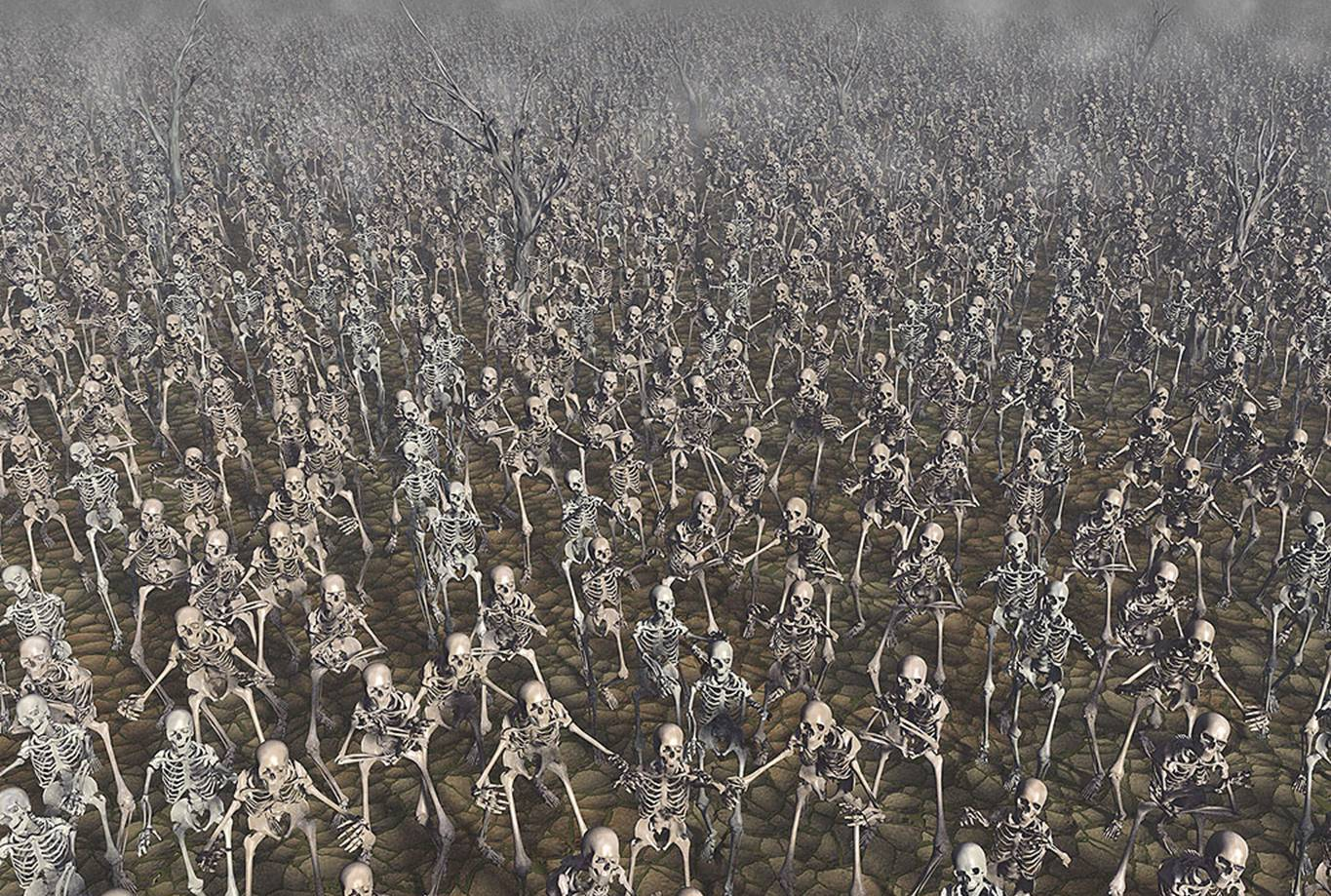
Can these bones live?
Notes:
Yahweh asks him this question. Interesting turn of the plot.
Ezekiel says only you know. Yahweh says tells the bones. That clatter together with flesh and tendons but no breath.

Slide 16
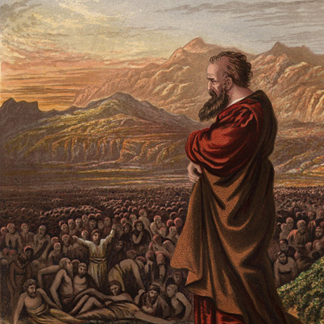
Tell the breath
Notes:
They are not animate creatures so Yahweh says tell the “breath”. The breath takes place and they are a great army.

Slide 17
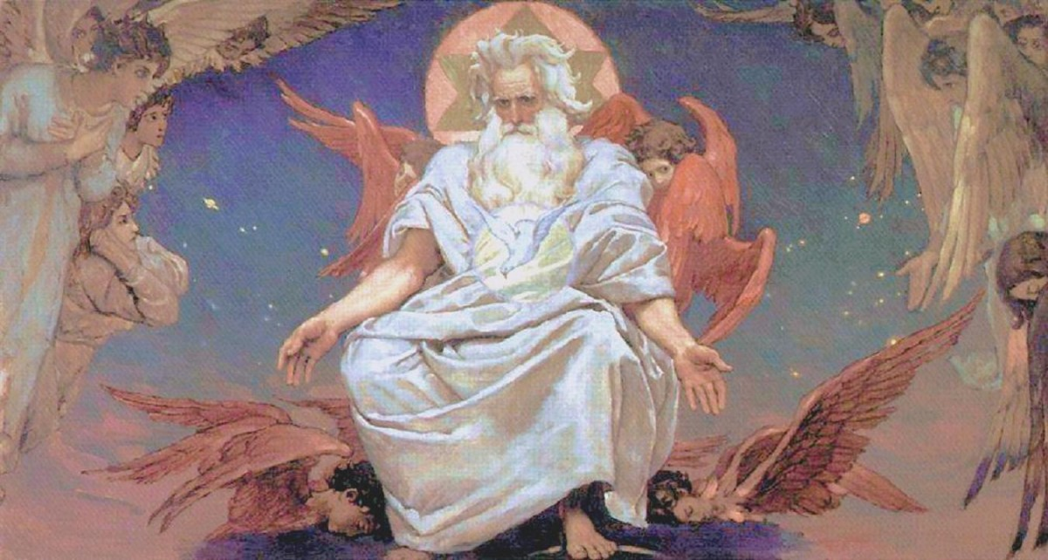
God gives commentary
Notes:
They are the bones of the people of Israel and I will bring you back to Israel.

Slide 18
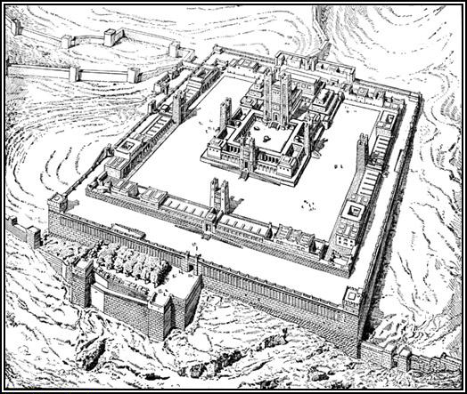
And then came the Temple…
Notes:
Says will bring back all the separate people under 1 King. And Gog is in big trouble. And I will return the temple.

Slide 19
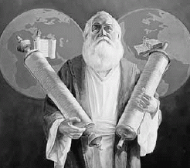
In Review
Ezekiel is a book about dreams of a return from Exile
It is an example of bringing the dead to life and thus why we are doing it at Easter
Notes:
Might add about a question about how this influenced the Pharisees

